Slide 1
Point Cloud

Slide 2
Outline
I
Basics
II
Methods
III
Accelerators

Slide 3
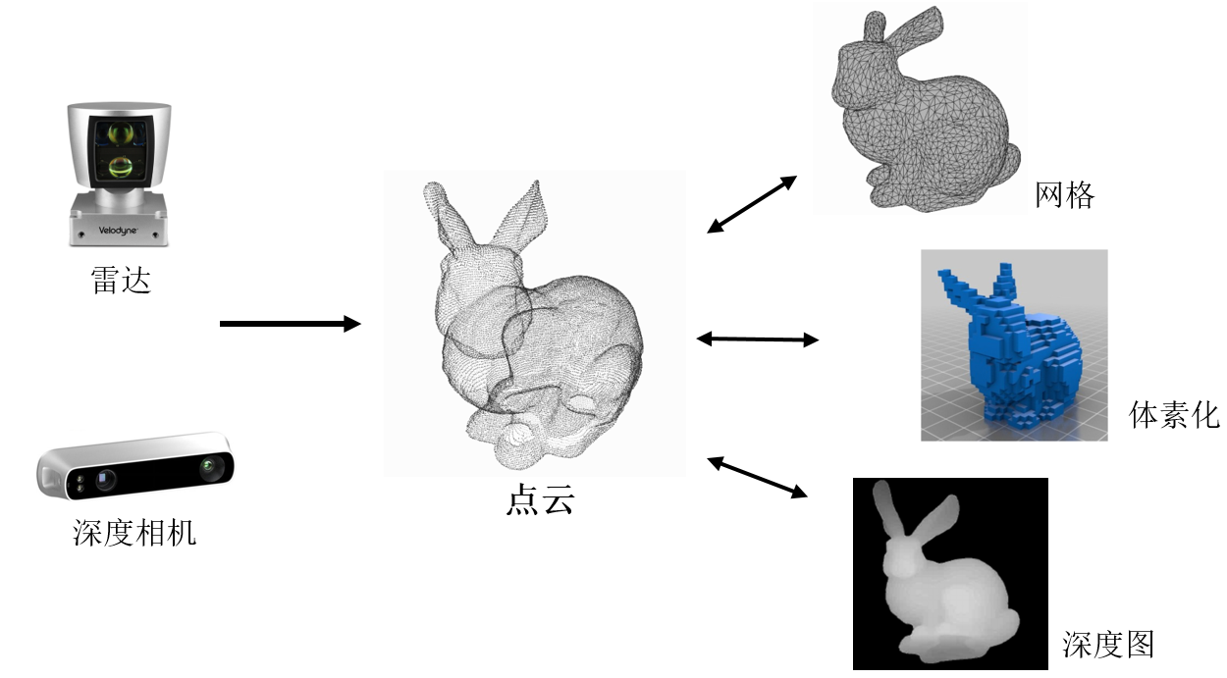
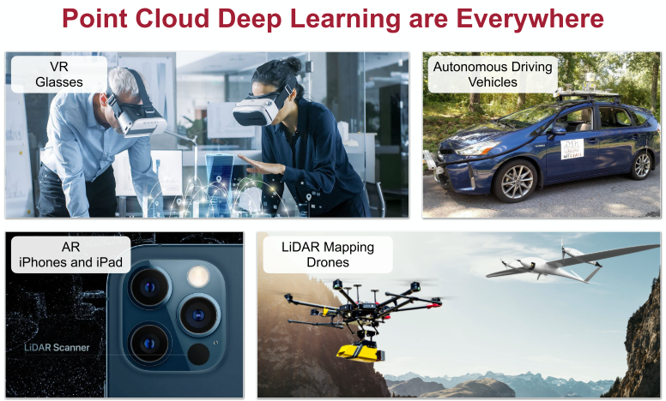
Point Cloud
原始采集数据
捕获3D形状
简单表示
N*(x, y, z, color)

Slide 4
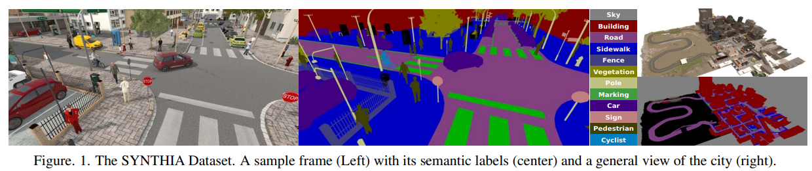
Dataset-合成
SYNTHIA (seg.) G. Ros et al. CVPR 2016

Slide 5
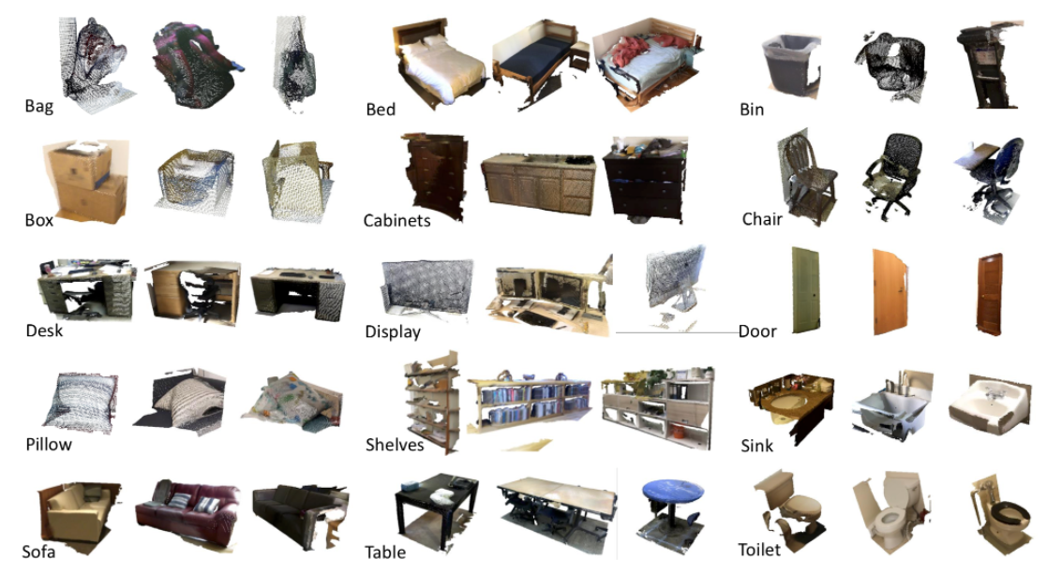
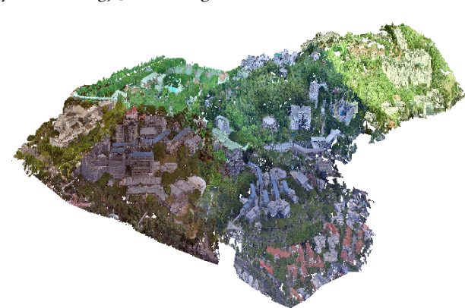
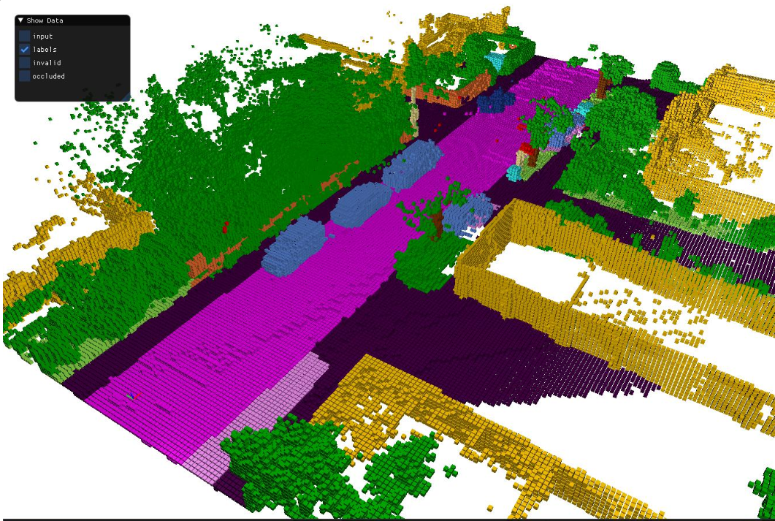
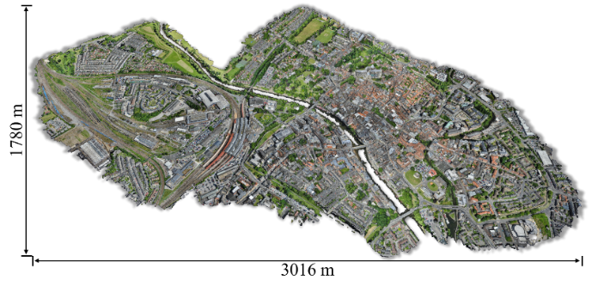
Dataset-真实
ScanObjectNN (class.)
M. A. Uy et al. ICCV 2019
Hu et al., Seg. of Urban-Scale 3D Point Clouds, CVPR 2021.
Li et al.,Campus3D (Outdoor Scene), MM 2020.
J. Behley et al. CVPR 2012
SemanticKITTI
J. Behley et al. ICCV 2019

Slide 6
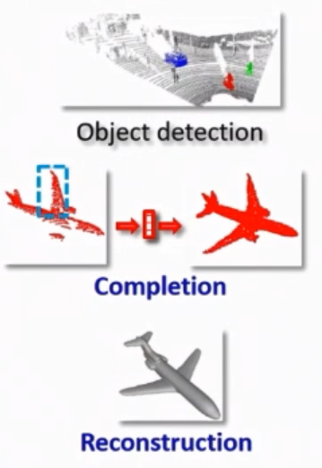
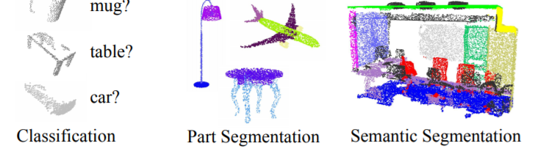
Tasks

Slide 7
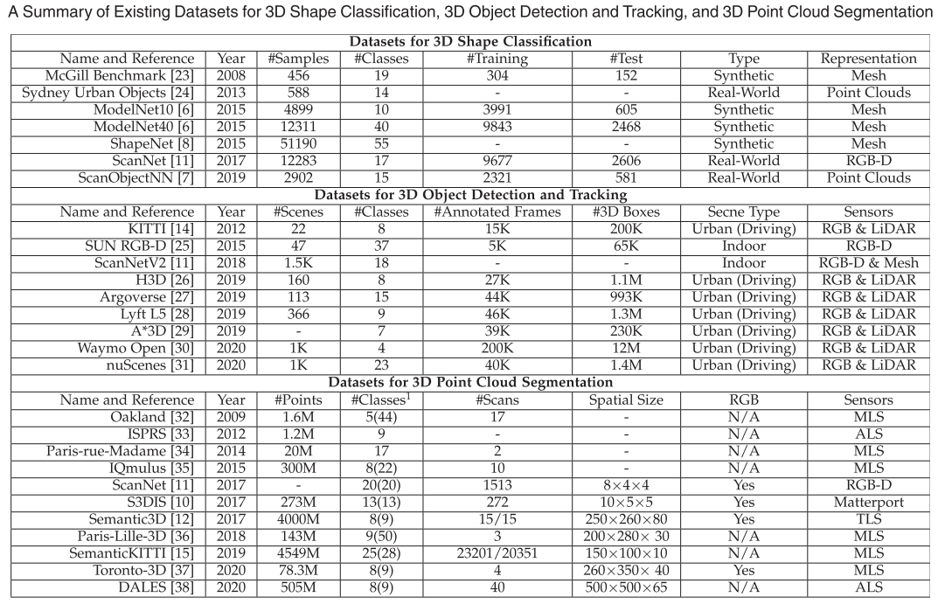
Summary of Datasets

Slide 8
Outline
I
Basics
II
Methods
III
Accelerators

Slide 9
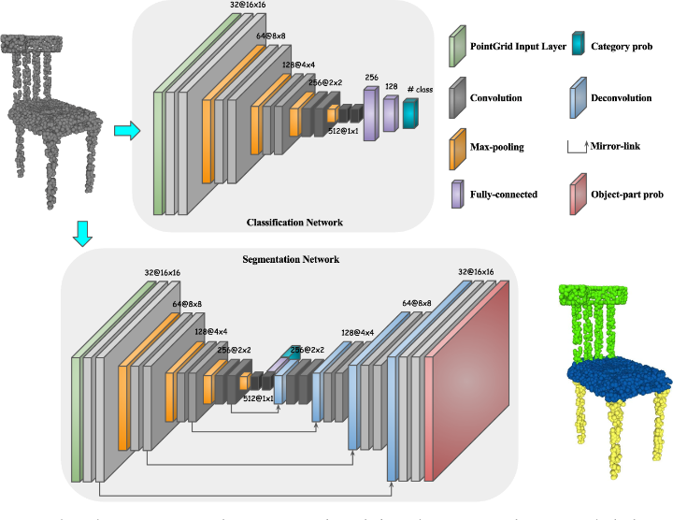
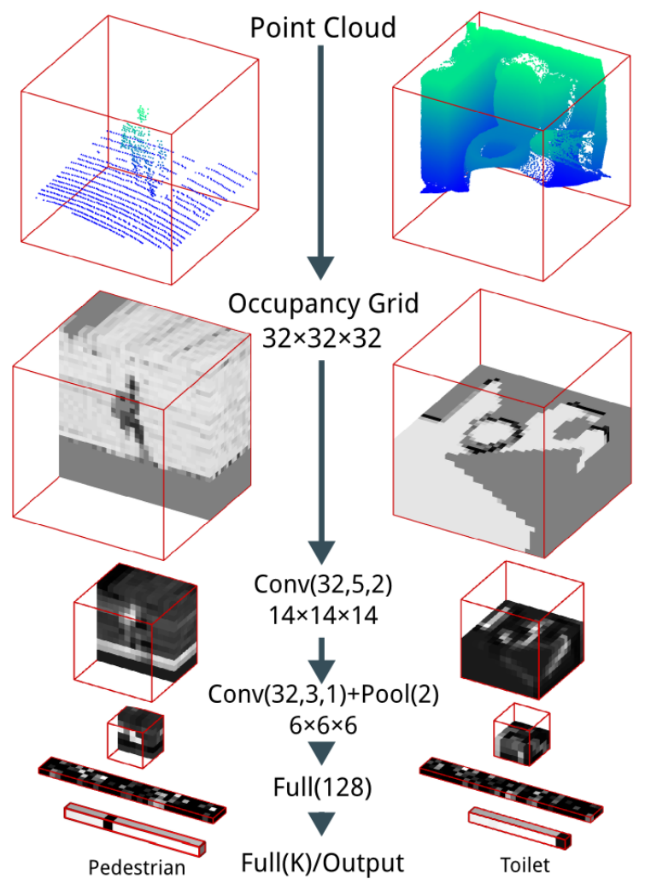
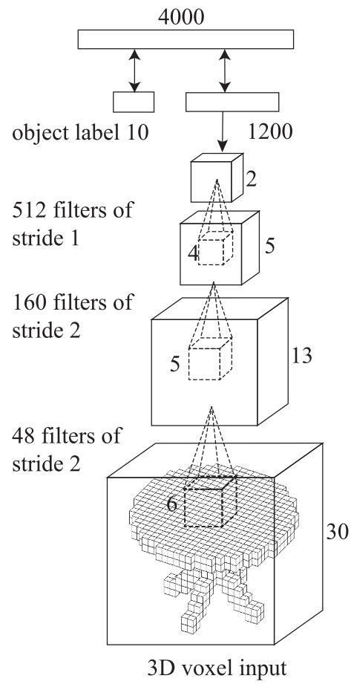
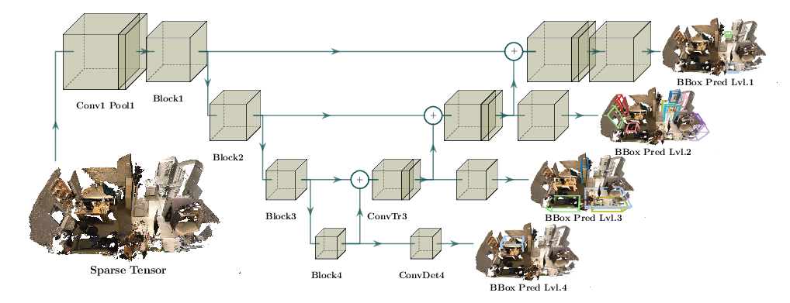
Volumetric-Based
3D CNN: VoxNet[1], 3D ShapeNets[2], PointGrid[3]
Submanifold[4], MinkowskiNet[5]

Slide 10
References
D. Maturana and S. Scherer, “VoxNet: A 3D convolutional neural network for real-time object recognition,” in Proc. of the IEEE/RSJ International Conference on Intelligent Robots and Systems, Sept. 2015, pp. 922-928.
Z. Wu, S. Song, A. Khosla, F. Yu, L. Zhang, X. Tang, and J. Xiao, “3D ShapeNets: A deep representation for volumetric shape modeling,” in Proc. of the IEEE Conference on Computer Vision and Pattern Recognition, Jun. 2015, pp. 1912-1920.
T. Le and Y. Duan, “PointGrid: A deep network for 3D shape understanding,” in Proc. the IEEE/CVF Conf. Comput. Vis. Pattern Rec- ognit., 2018, pp. 9204–9214.
B. Graham, M. Engelcke, and L. van Maaten, “3D semantic segmentation with submanifold sparse convolutional networks,” in Proc. of IEEE/CVF Conference on Computer Vision and Pattern Recognition, Jun. 2018, pp. 9224-9232.
C. Choy, J. Y. Gwak, and S. Savarese, “4D spatio-temporal convnets: Minkowski convolutional neural networks,” in Proc. of the IEEE/CVF Conference on Computer Vision and Pattern Recognition (CVPR), Jun. 2019, pp. 3070-3079.

Slide 11
Sparse Conv-Regular Output[1]
只要核覆盖一个输入点就计算输出点，稀疏性会下降
对H的key遍历，确定卷积输出feature map上不为空的坐标与个数，组成H_{out}
由H_{out} 记录的不为空位置，反推所需要的输入feature map的位置(记录在rule book)，从而得到输入H该位置对应的key，最后取出对应的feature
B. Graham, “Sparse 3D convolutional neural networks,” in Proc. of the British Machine Vision Conference, 2015, pp. 150.1-150.9.

Slide 12
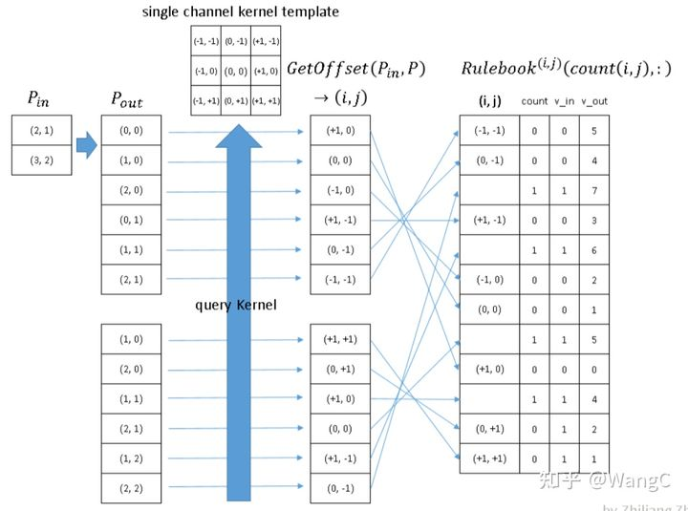
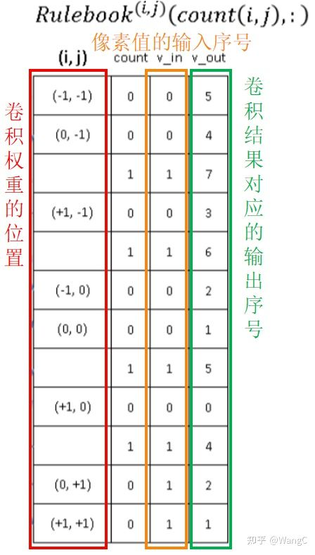
Sparse Conv-Regular Output

Slide 13
Sparse Conv-Submanifold[1](子流形)
只有当核中心覆盖输入点才计算输出点，保持一样的稀疏性
改动为：输出feature map与输入feature map上不为空的位置相同，直接把H_{in}复制到H_{out}
为了突破感受野的限制，结合maxpooling或stride=2
B. Graham, M. Engelcke, and L. van Maaten, “3D semantic segmentation with submanifold sparse convolutional networks,” in Proc. of IEEE/CVF Conference on Computer Vision and Pattern Recognition, Jun. 2018, pp. 9224-9232.

Slide 14
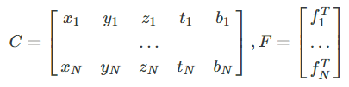
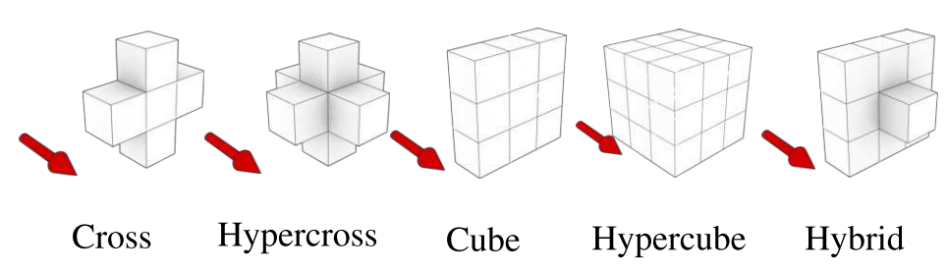
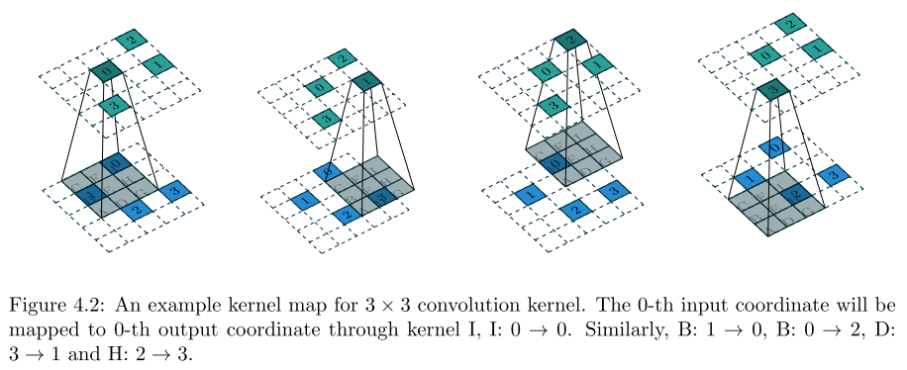
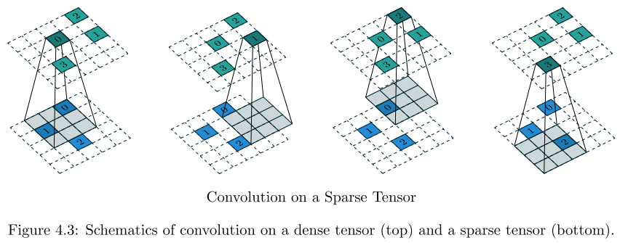
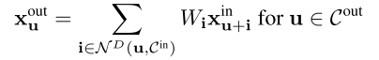
Minkowski Convolution
点云体素化(基于Minkowski距离)后COO排
Kernel map：由输出点的位置找输入点的位置(对应关系)
计算过程：Cout坐标结合kernel map推出Cin点坐标，在hash table找出row index(C中哪一行)，再取feature与weight相乘

Slide 15
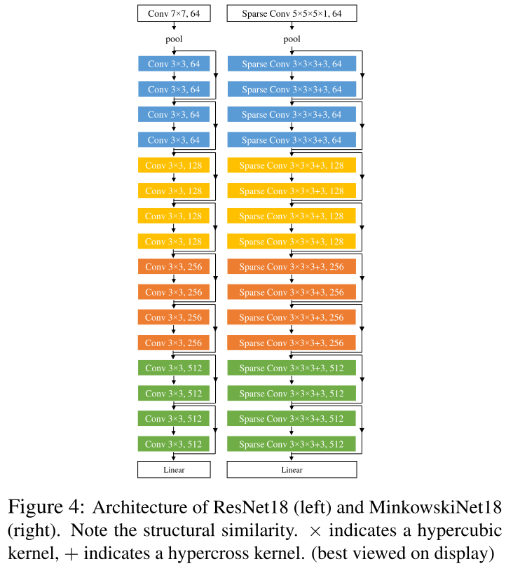
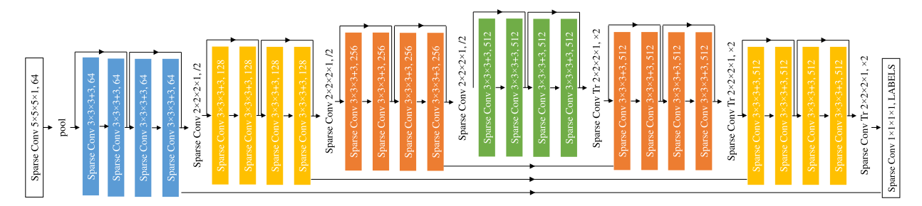
Minkowski Networks
MinkowskiUNet32

Slide 16
Minkowski 优缺点
通用点云高维稀疏卷积
原理上与3D卷积无区别：
迁移性：基于成熟的2DCNN对图像的，能迁移到点云
通用性：无论多维，密或稀疏均可计算（点云和图像均可计算）
MinkowskiEngine提供基本组件，可以灵活调整网络结构和规模；灵活调整卷积方式（kernel形状，输出点位置），兼容Submanifold；越高分辨率，越稀疏，加速效果越好
常作baseline，顶会10多篇使用MinkowskiEngine，Nvidia官方支持库
缺点
原始MinkowskiNet与其它网络相比参数量和计算量大(1M参数量->5G计算量)，需要探索轻量化([1]只有1.1M参数量)，稀疏卷积均需要查Hash表占用硬件资源和时间周期
使用问题：自定义计算库训练可能出问题，后续量化剪枝可能不好做
可能已经有工作在做硬件
J. Komorowski, “MinkLoc3D: Point cloud based large-scale place recognition,” in Proc. of the IEEE/CVF Winter Conference on Applications of Computer Vision, Jan. 2021, pp. 1790-1799.

Slide 17
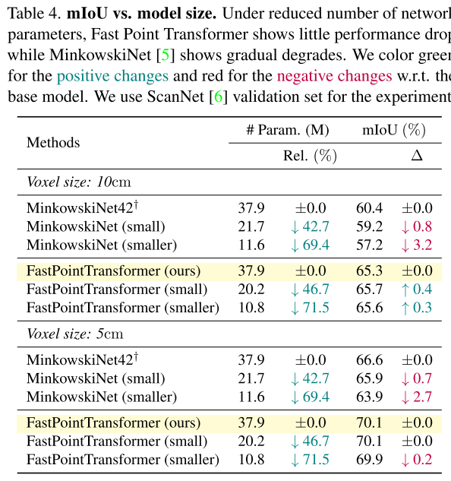

Slide 18
Point-Based
MLP-Based Methods
PointNet[1], PointNet++[2], PointMLP[3]
Convolution-Based Methods
PointConv[4], PointCNN[5]
Graph-Based Methods
DGCNN[6]
C. R. Qi, H. Su, K. Mo, and L. J. Guibas, “PointNet: Deep learning on point sets for 3D classification and segmentation,” in Proc. the IEEE Conf. Comput. Vis. Pattern Recognit., 2017, pp. 77–85.
C. R. Qi, L. Yi, H. Su, and L. J. Guibas, “PointNet++: Deep hierar- chical feature learning on point sets in a metric space,” in Proc. of the International Conference on Neural Information Processing Systems, 2017, pp. 5105–5114.
X. Ma, C. Qin, H. You, H. Ran, and Y. Fu, “Rethinking network design and local geometry in point cloud: A simple residual MLP framework,” in Proc. of the International Conference on Learning Representations, Apri. 2022.
W. Wu, Z. Qi, and L. Fuxin, “PointConv: Deep convolutional net- works on 3D point clouds,” in Proc. of the IEEE/CVF Conf. Comput. Vis. Pattern Recognit., 2019, pp. 9613–9622.
Y. Li, R. Bu, M. Sun, W. Wu, X. Di, and B. Chen, “PointCNN: Convolution on X-transformed points,” in Proc. of the Int. Conf. Neural Inf. Process. Syst., 2018, pp. 820–830.
Y. Wang, Y. Sun, Z. Liu, S. E. Sarma, M. M. Bronstein, and J. M. Solomon, “Dynamic graph CNN for learning on point clouds,” ACM Transactions on Graphics, vol. 38, no. 5, pp. 1–12, Oct. 2019. (Cited by 2318)

Slide 19
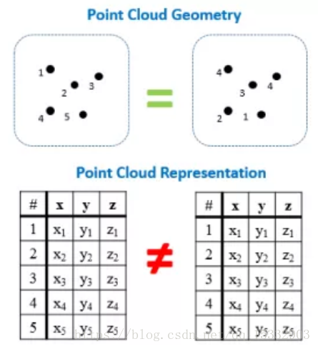
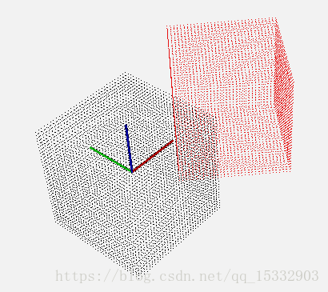
PointNet-Challenges
简单、高效、强大的特征提取器(encoder)=AlexNet
无序性
旋转性
分类与分割任务对feature要求不同

Slide 20
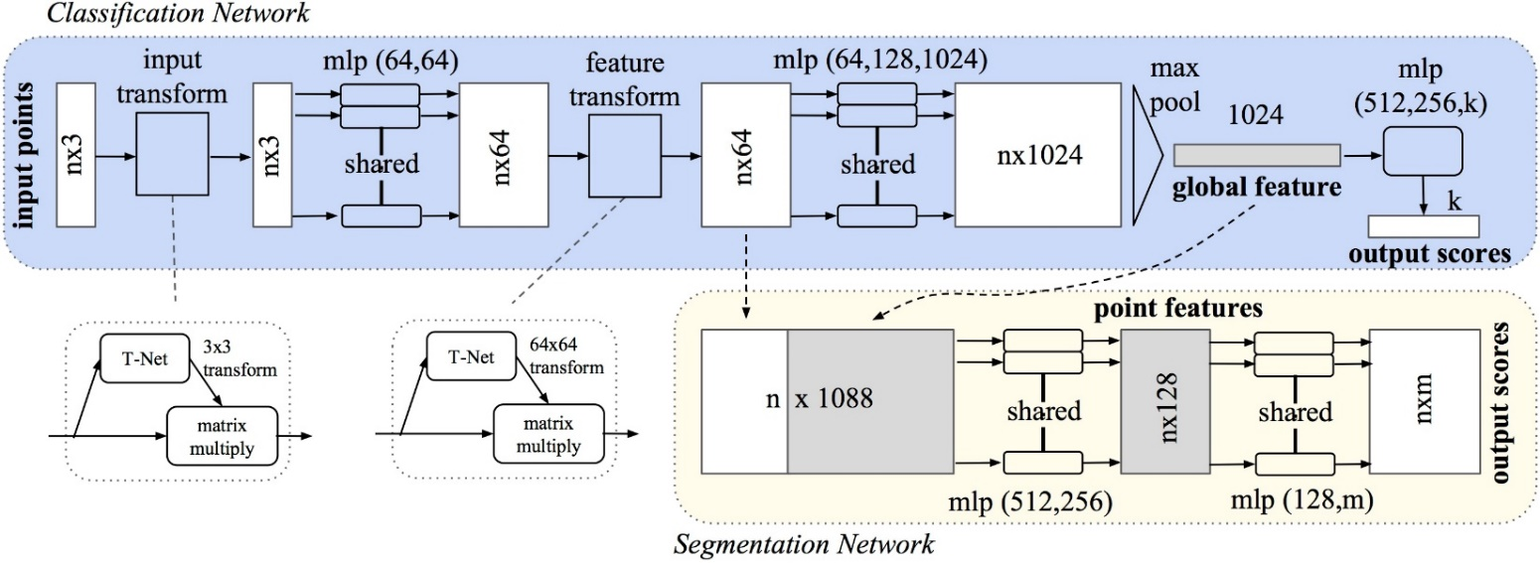
PointNet-Solutions
无序性：用MLP解决+Maxpooling
MLP: 多层conv2d(input_image[B, n, 1, 1], 64, [1,1])，Kernel共享减少参数量，卷积只改变通道数
旋转性：点云位置变换+特征变换
T-Net(MLP+Maxpooling提取global feature并reshape到3x3或64x64) +MatMul；
Global feature用于分类，结合point-wise feature用于分割

Slide 21
PointNet++-Motivations
主要是针对PointNet对feature信息提取存在的问题
local feature: 仅直接对点表征，整合能力太弱
global feature: 直接max-pooling，造成巨大信息损失
global feature与local feature结合：直接拼接，生成discriminative feature能力有限

Slide 22
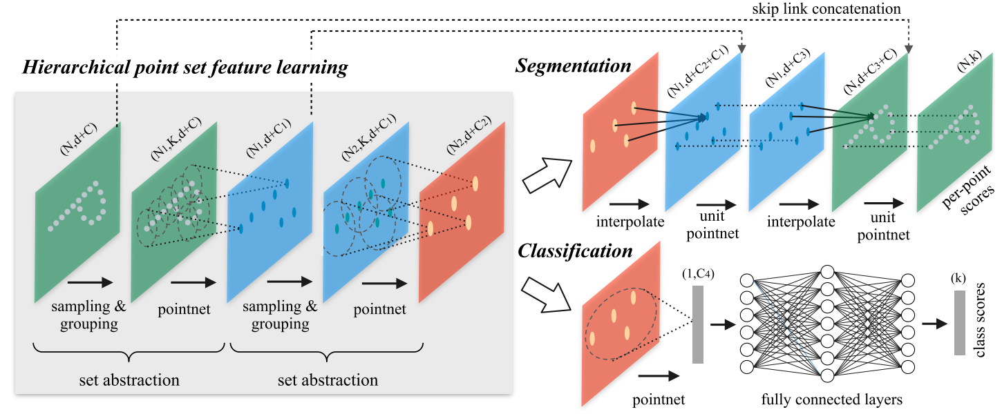
PointNet++-Solutions
改进
local feature: sampling和grouping整合局部邻域
global feature: hierarchical feature learning framework，通过多个set abstraction逐级降采样，获得不同规模不同层次的local-global feature
global feature与local feature结合：分割任务设计了encoder-decoder结构，先降采样再上采样，使用skip connection将对应层的local-global feature拼接

Slide 23
Sampling and Grouping

Slide 24
Furthest Point Sampling(FPS)

Slide 25
K-Nearest Neighbor(KNN)

Slide 26
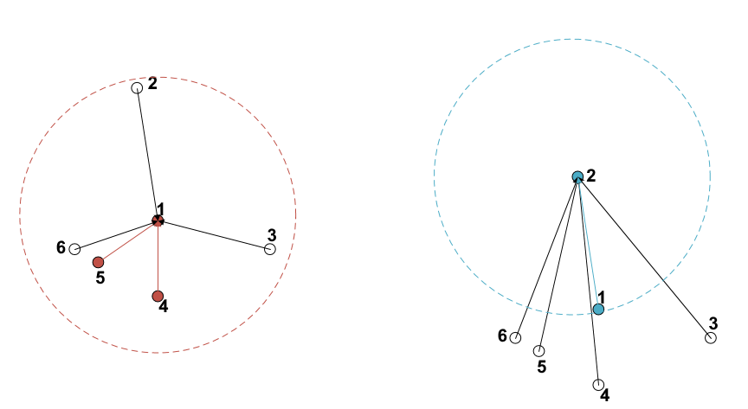
Ball Query(BQ)

Slide 27
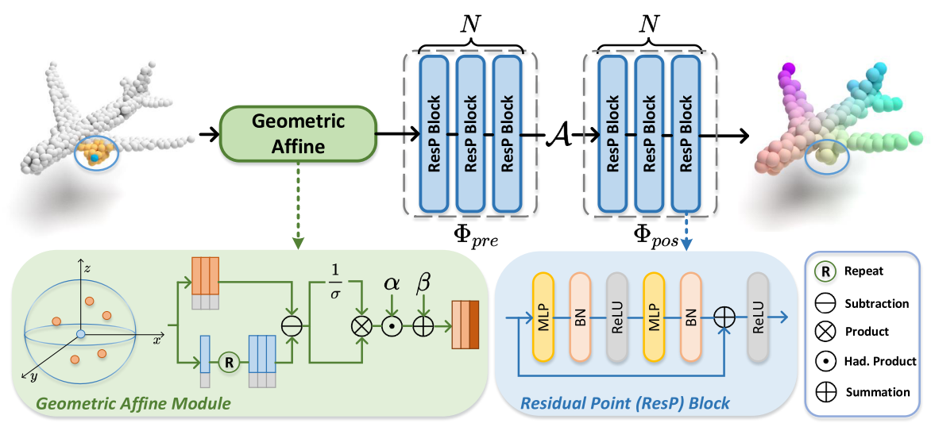
PointMLP
架构合理简单：用MLP和残差从局部到全局特征提取
Geometric Affline为了让几何分布统一
PreMLP是提取局部特征，PosMLP是提取全局特征
Aggregation用Max-pooling实现
比肩ResNet，ICLR2022刚提出，各任务均取得SOTA

Slide 28
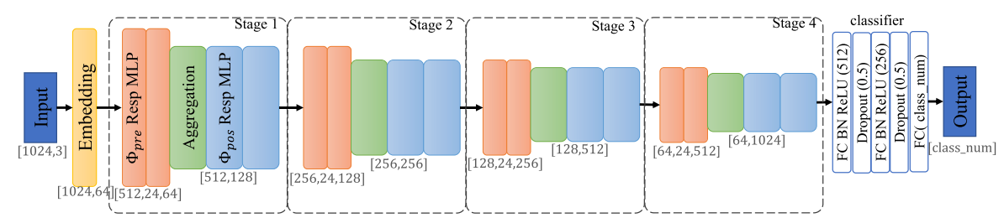
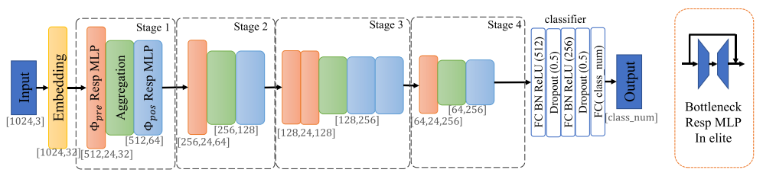
PointMLP-elite
灵活调整模型规模：减少通道数和级数
elite版本的FC层通道数减少4倍
elite版本0.68M参数量(AlexNet的1%)和0.8G计算量 ((1M参数量->1G计算量)

Slide 29
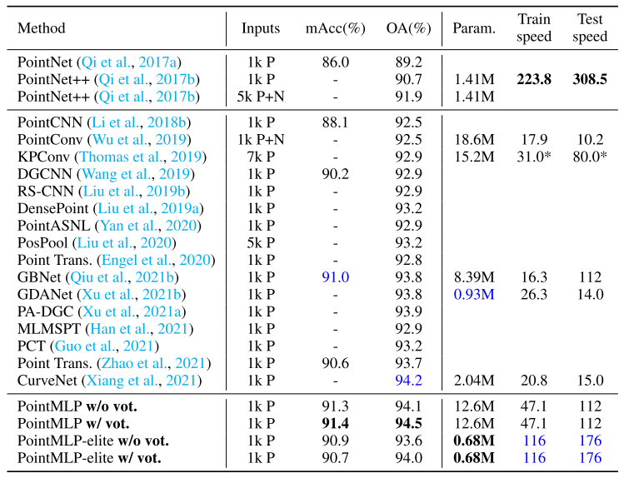
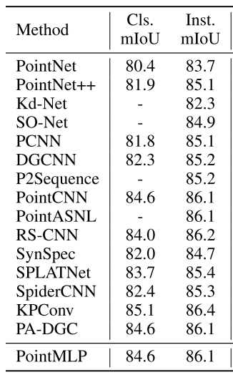
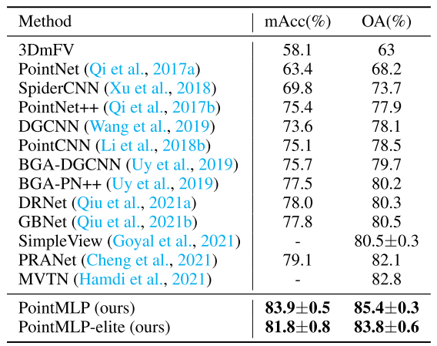
PointMLP-Results
ModelNet40 (1K points)
ScanObjectNN
ShapeNetPart

Slide 30
DGCNN-Motivations
点云中点是离散的
点之间的关联是有实际意义的
建立点云中点与点之间的拓扑关系可以增强特征提取能力
Y. Wang, Y. Sun, Z. Liu, S. E. Sarma, M. M. Bronstein, and J. M. Solomon, “Dynamic graph CNN for learning on point clouds,” ACM Transactions on Graphics, vol. 38, no. 5, pp. 1–12, Oct. 2019. (Cited by 2318)

Slide 31
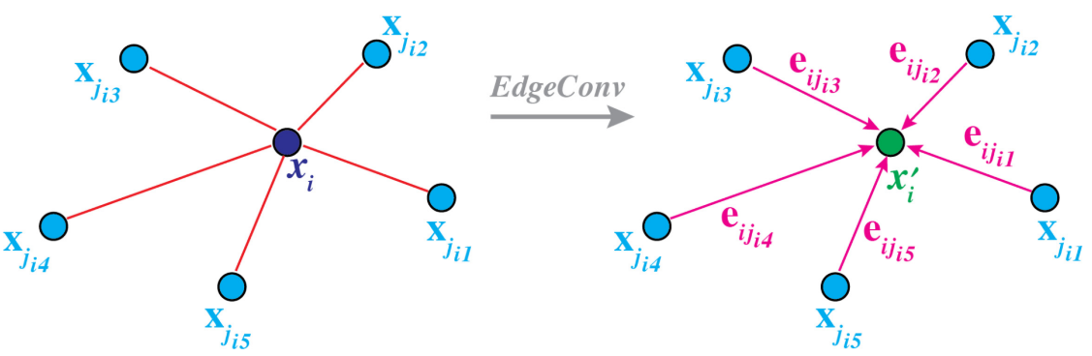
DGCNN-Solution: EdgeConv
EdgeConv在网络的每一层上动态构建图结构，将每一点作为中心点来表征其与各个邻点的edge feature，再将这些特征聚合从而获得该点的新表征
EdgeConv（边卷积）实现的实际就是通过构建局部邻域（这种局部邻域既可以建立在坐标空间，也可以建立在特征空间），对每个点表征
将多个EdgeConv模块首尾相接不断堆叠也就是为了获得多层次、具有更加丰富语义的表征，EdgeConv输入N*F，输出N*F¹

Slide 32
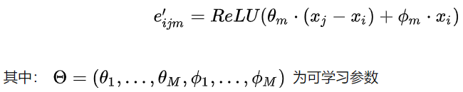
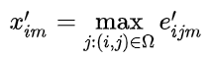
DGCNN-Solution: EdgeConv
Step1: 构建图结构
顶点就是点云中各个点
边是通过对每个点KNN，连接其K近邻来构建（PointNet可以看成是在KNN时设置k=1的情况)
Step2: 计算edge feature（边表征）
既考虑本身xi， 又考虑了邻域信息xj-xi
Step3:聚合edge feature，对其对应的中心点表征新的特征
Max pooling

Slide 33
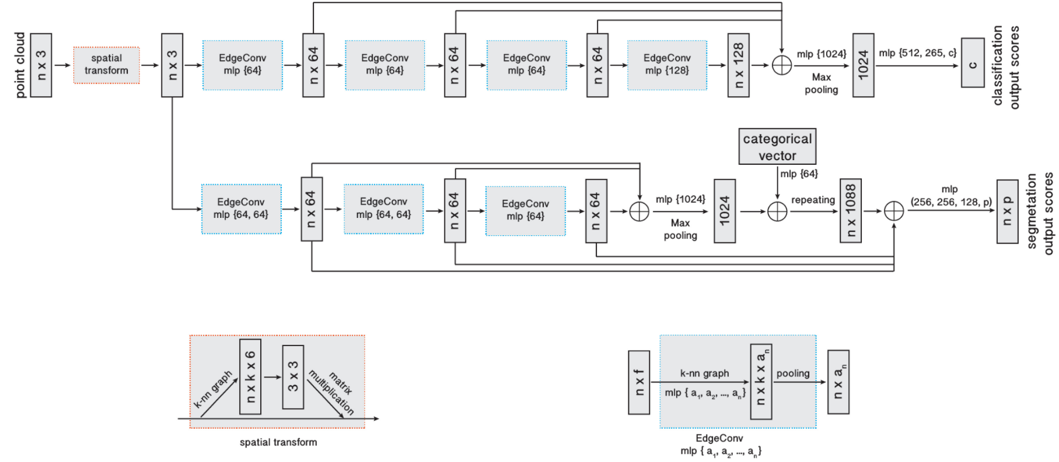
DGCNN-Solution: Network Architecture
不断堆叠每一层EdgeConv的表征结果
Step1: 逐级对输入（包括坐标空间和特征空间）使用EdgeConv模块表征point-wise feature
相比于pointnet，多个提取邻近k个点的关联特征这一维
b*n*1*f（原始点云）计算邻近的K个点的edge feature得到b*n*k*f，再mlp多个卷积输出通道a1, a2, …an最后得到b*n*k*an
Step2: 将不同层次的point-wise feature拼接起来，通过max pooling得到global feature
Step3: 接MLP

Slide 34
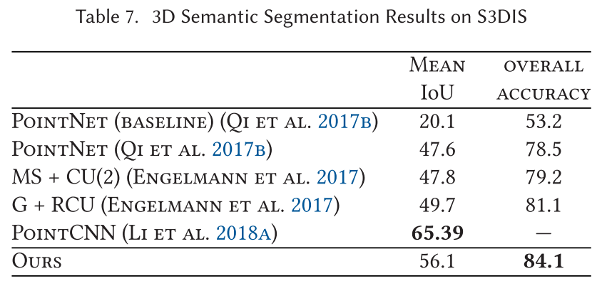
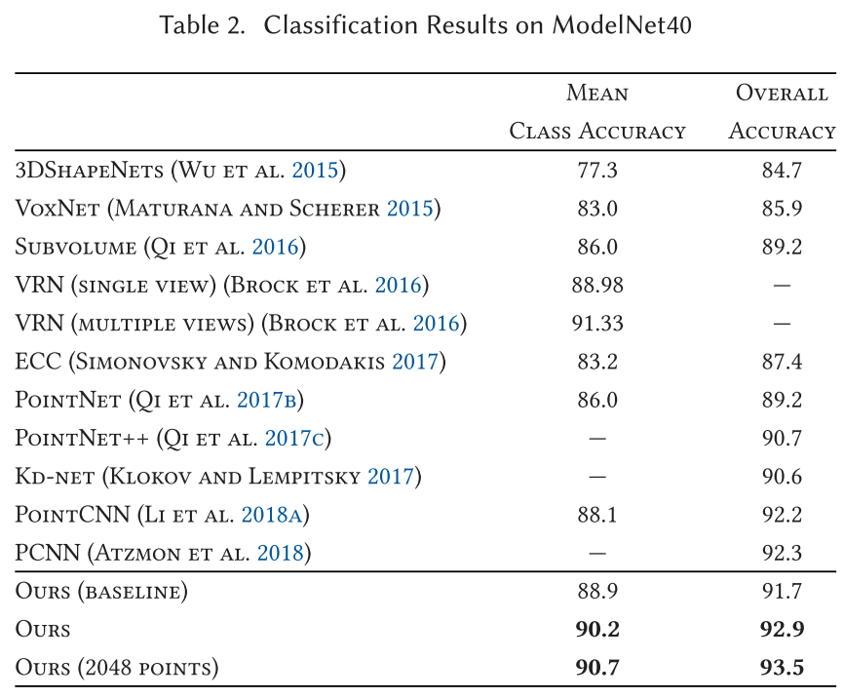
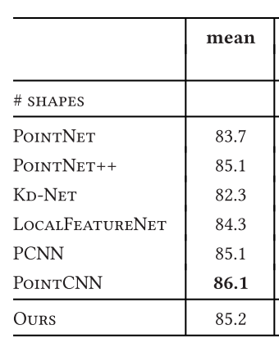
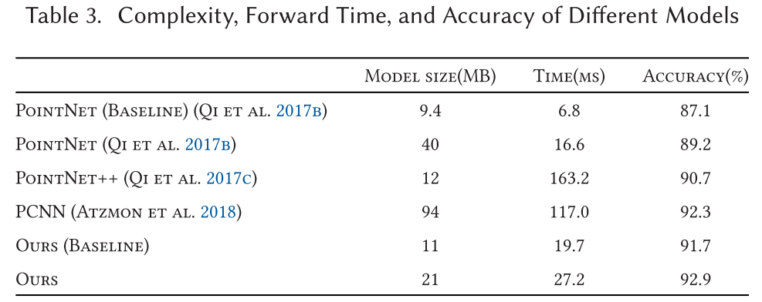
DGCNN-Results
ShapeNet Part

Slide 35
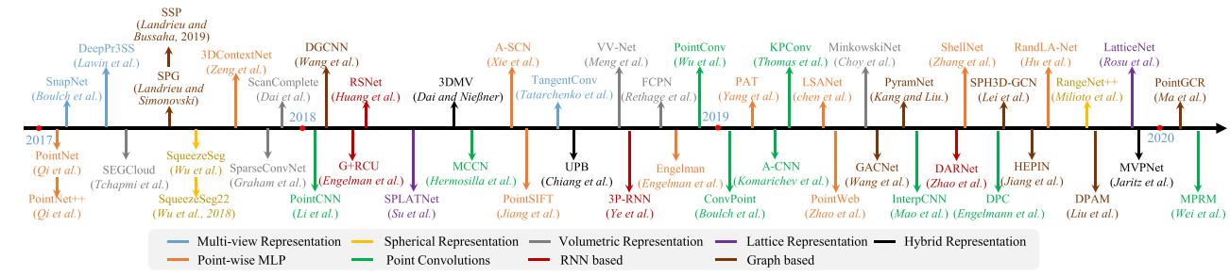
Other Methods
Multi-view based methods
MVCNN[1]
H. Su, S. Maji, E. Kalogerakis, and E. Learned-Miller, “Multi- view convolutional neural networks for 3D shape recognition,” in Proc. of the IEEE Int. Conf. Comput. Vis., 2015, pp. 945–953.

Slide 36
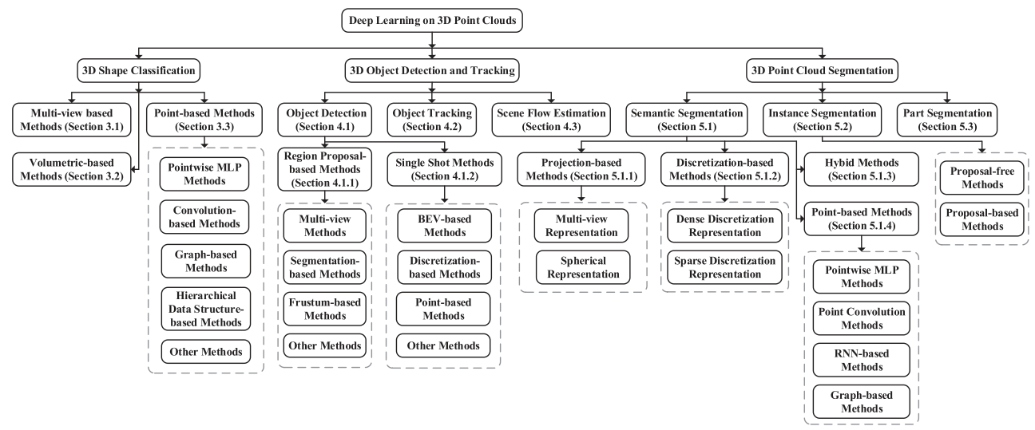
Summary of Methods

Slide 37
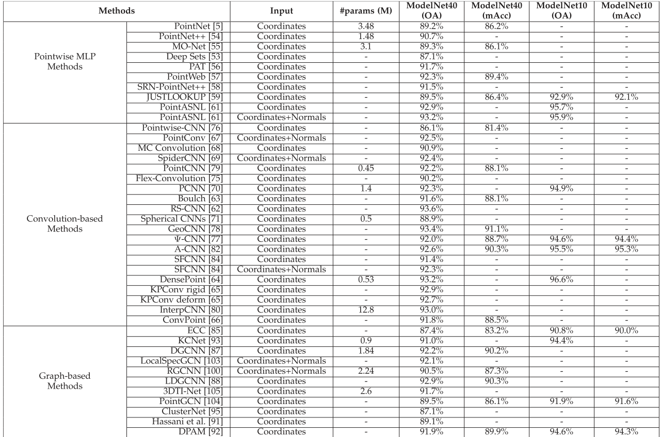
Summary of Methods

Slide 38
Complexity & IoU/Accuracy
 | Parameters /M | MAC operations /G | IoU/Accuracy /%
AlexNet | 61.0 | 0.73 | 84.7@ImageNet
VoxNet | 0.9 | > 0.1 | 83@ModelNet40
PointNet | 3.6 | 0.93 | 14.6@SemanticKITTI; 89.2@ModelNet40; (41.1 mIoU, 49.0 Acc) @S3DIS
PointNet++ | 1.41 | 2.97 | 20.1@SemanticKITTI; 90.7@ModelNet40; 54.2@ScanNet;
PointConv | 18.6 | - | 92.5@ModelNet40; 61.0@ScanNet
FastPointTransformer | 37.9 | - | 72@ScanNet; (67.5mIoU, 74.7 Acc) @S3DIS
PointMLP40 | 12.6 | - | 94.5@ModelNet40; 83.9@ScanObjectNN; (84.6 Cls.mIoU, 86.1 Inst.mIoU)@ ShapeNetPart
PointMLP-elite | 0.68 | 0.8 | 94.0@ModelNet40; 81.8@ScanObjectNN
DGCNN | 1.8 | 2.8 | 92.9@ModelNet40, 85.2mIoU @ShapeNetPart, (56.1mIoU, 84.1Acc) @S3DIS
MinkowskiNet(best) | - | - | 73.4@ScanNet; (66.0mIoU, 73.3 Acc) @S3DIS
MinkowskiUNet42 | 37.9 | - | 66.6@ScanNet; (66.0mIoU, 73.3 Acc) @S3DIS
MinkowskiUNet32 | 21.7 | 114 | 63.1@SemanticKITTI; 65.9@ScanNet; (78.67 mIoU, 90.51 Acc) @4D Synthia; (65.35 mIoU, 71.17 Acc) @S3DIS
MinkowskiNet20 | 11.6 | - | 63.9@ScanNet; (77.46 mIoU, 88.0 Acc) @4D Synthia; (62.60 mIoU, 69.62 Acc) @S3DIS
MinkowskiNet-mini | 2.2 | 11 | 57.5@SemanticKITTI
Dataset SOTA |  |  | 95.4(PointView-GCN)@ModelNet40; 85.7(PointMLP)@ScanObjectNN(cla.); 78.1(Mix3D)@ScanNet(seg.); (87.7, 86.6)(FG-Net)@ShapeNetPart(seg.); 70.8(AF2S3Net)@SemanticKITTI(seg.); (74.7mIoU, 83.8 mAcc)(DeepViewAgg)@S3DIS(seg.);

Slide 39
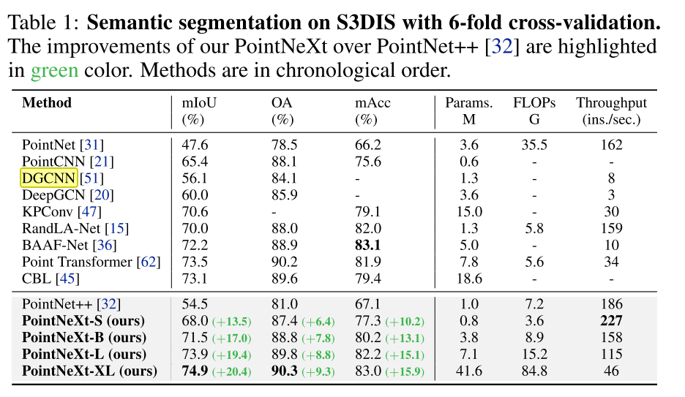
PointNeXt

Slide 40
网络总结
Minkowski convolution通用，因为基于体素，能完全反映空间位置，虽然是稀疏卷积，但相对于使用point-based methods计算量参数量仍然大
PointMLP-elite和DGCNN都说明point-based methods模型小
DGCNN从原理上更关注邻域关联信息，高引用，常作为backbone

Slide 41
Outline
I
Basics
II
Methods
III
Accelerators

Slide 42
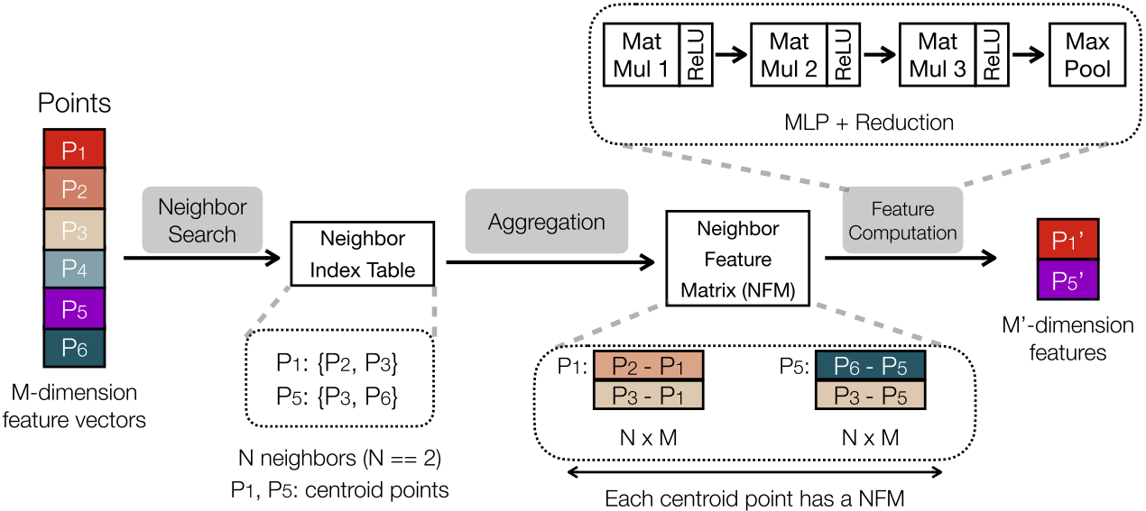
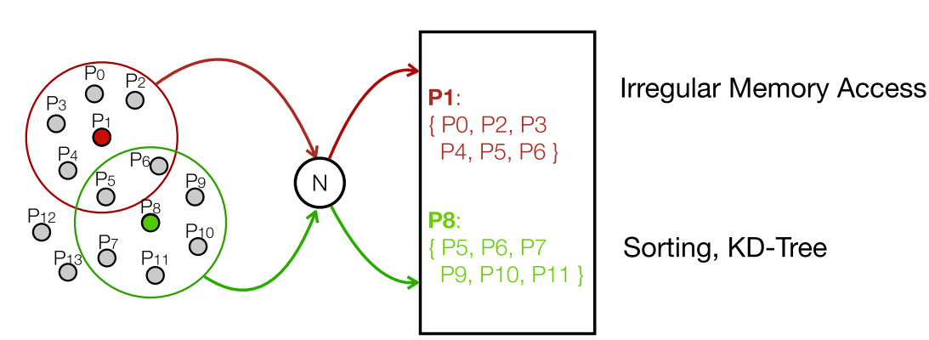
Mesorasi-Challenges
点云是散点，需要Neighbor search找点集来计算输出点， DRAM不规则
一个输入点被多个Neighbor域所共享，DRAM读取次数多
Neighbor Feature Matrix由输入点组合而来，数量多，计算量大

Slide 43
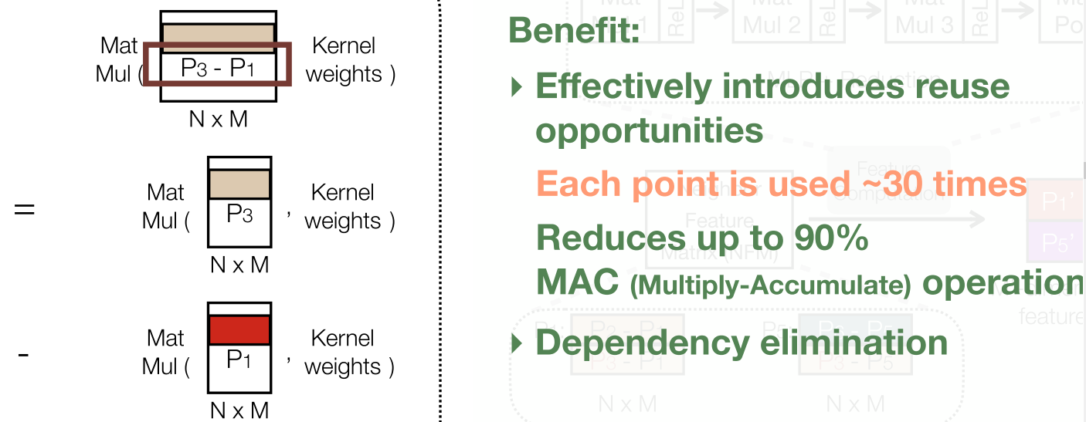
Mesorasi-Solution
Neighbor feature matrix与kernel矩阵乘法可以拆分成输入点与kernel矩阵乘法
ReLU这种非线性也强制拆分，这种近似导致-0.9%-+1.2% accuracy波动

Slide 44

Mesorasi-Delay Aggregation
Decouples neighbor search with feature computation
片上并行计算

Slide 45

Mesorasi-Acceleration Frame

Slide 46

Mesorasi-Overall Hardware Design
With 3.8% area overhead to the NPU

Slide 47


Mesorasi-Experimental Results

Slide 48

PNNPU[1]-Network
定制优化实现VoteNet[2]@SUN RGB-D (object detection)
S. Kim, J. Lee, D. Im and H. -J. Yoo, "PNNPU: A 11.9 TOPS/W high-speed 3D point cloud-based neural network processor with block-based point processing for regular DRAM access," in Proc. of Symposium on VLSI Circuits, Jun. 2021, pp. 1-2.
C. R. Qi, O. Litany, K. He, and L. Guibas, “Deep Hough voting for 3D object detection in point clouds,” in Proc. of IEEE/CVF International Conference on Computer Vision, pp. 9277-9286, Oct. 2019.

Slide 49


PNNPU-Challenges
解决的问题
点处理复杂低效-计算量和数据访问量正比于n²
卷积时，不规则频繁片外DRAM访问
大尺度Max-pooling(i.e. 128)引起大量前层卷积操作无效

Slide 50


PNNPU-Construct-HFPS
Hierarchical Block-wise FPS
基于block内，随机采样的点数与FPS点数相似
Level-1: 确定每个block采样点个数-两次随机降采样
Level-2: block内部FPS
达到目的：减少计算复杂度、减少访问量和访问规则高效（以block为单位）

Slide 51

PNNPU-Neighbor Search-BSBQ
Block-skipping Ball Query
只需要距离近的block，绝大多数远的block无需要比较
达到目的：减少计算复杂度和减少访问量

Slide 52

PNNPU-Memory Manage with Paging
block不平衡
对计算单元来说需要取整个block的连续page，对存储单元来说每次只取block的一个小块即page，不同block的page交叉，那么就需要一个table来对应
Paging方法的问题：每个block的page table尺寸固定，但block的page数少，table利用率低，block数多时，table占用存储空间大

Slide 53

PNNPU-Memory Manage with LLPT
Linked List-based Page Table
建立只有分配的block的所有page的相关性形成链表，即一个block从第一个page怎么找到下一个page直到所有page。
指定block的起始page，这样一个block的所有page在整个memory都能找到

Slide 54



PNNPU-Max-pooling Prediction
前提是Max-pooling前一层是1x1 Conv
MPP：使用lightweight 1x1Conv提前筛选top-k(e.g., 64减少到4)

Slide 55

PNNPU-Prediction with Large Value Input
Input Skip: 设定th只保留大值|x|

Slide 56



PNNPU-Results
4mJ/f

Slide 57



PointAcc[1]-Observation
运行点云网络相对于2D CNNs效率低
7✕ less #MACs but 1.3✕ slower
稀疏性
稀疏性来源于物理空间上点的分布
在处理过程中保持稀疏性
Y. Lin, Z. Zhang, H. Tang, H. Wang, and S. Han, “PointAcc: Efficient point cloud accelerator,” in Proc. of the IEEE/ACM International Symposium on Microarchitecture, Oct. 2021, pp. 449-461.

Slide 58

PointAcc-Challenges
需要大量map操作来建立输入输出点之间的关系
Irregular sparse computation pattern requires explicit gather and scatter of point features for matrix computation, which results in a massive memory footprint
Due to extreme sparsity, mapping operations and data movement overhead together take up >50% of the total runtime latency

Slide 59


PointAcc-Solutions
5 Steps and 3 Units
Memory Management Unit bridges the other two units by preparing the data for Matrix Unit based on the output of Mapping Unit.
Flexible supports various point cloud networks

Slide 60


PointAcc-Key 1: Diverse Mapping
Mapping Unit生成(In, Out, Wgt)
Ball Query, Kernel Mapping, and KNN

Slide 61


PointAcc-Mergesort
Mergesort-based Kernel Mapping
按坐标融合排序，相同坐标取出来组成map

Slide 62

PointAcc-One Versatile Arch
以FPS为例，两条关键路径：min更新dist，max更新output point

Slide 63


PointAcc-Key 2: MXU-Streaming MatMul
Fetch-on-Demand flow：对输入建立buffer，分成tile
point数远多于filter数(oc)，采用WS，SA中一行PE计算一个filter(ic并行)，不同行计算多个filter(oc并行)
SA中也采用OS累加psum
OS和WS减少DRAM访问

Slide 64


PointAcc-Key 3: MMU-Layer Fusion
Temporal Layer Fusion on consecutive FCs
简单逻辑，大buffer利于灵活的tiling，灵活的fusion层个数

Slide 65


PointAcc-Comparison with GPU
Consistent improvement on diverse networks and hardware platforms

Slide 66


PointAcc-Comparison with Mesorasi[1]
Mini-MinkNet mIoU远高于PointNet++
加速Mini-MinkNet很可能有较大收益
Y. Feng, B. Tian, T. Xu, P. Whatmough, and Y. Zhu, “Mesorasi: Architecture support for point cloud analytics via delayed-aggregation,” in Proc. of the IEEE/ACM International Symposium on Microarchitecture, Oct. 2020, pp. 1037-1050.

Slide 67


PointAcc-Source of Performance Gain
使得MatMul依然主导能耗和时间

Slide 68


Point-X
PPA
提高并行度，减少计算量
数据复用，减少数据移动，减少计算量
改写之后：
计算量减少了(phi和theta固定的)3次乘法变为2次乘法
fpsum复用：phi*边可以被复用
整篇论文围绕着这个公式
J.-F. Zhang and Z. Zhang, “Point-X: A spatial-locality-aware architecture for energy-efficient graph-based point-cloud deep learning,” in Proc. of the IEEE/ACM International Symposium on Microarchitecture, Oct. 2021, pp. 1078-1090.

Slide 69

Point-X-Clustering Algorithm
目的是增加片内并行计算，减少片间通信
clustering分组重构点云，让尽量多的点在一个组内，分到一个计算tile，减少片间通信同时缩短片间通信的距离

Slide 70


Point-X-Clustering Hardware
SBFS(speculative breadth-first search) graph traversal algorithm
并行处理得到近似分组

Slide 71

Point-X-Clustering Results
极大提升组内边比例，减少组间边距离（间隔多少个cluster)

Slide 72


Point-X-Chain NoC
目的是组之间通信复用fpsum
作为baseline:
query复杂度高全互联不可scale up且冲突多
exchange latency大且带宽可能不够
设计考量是高带宽和低复杂度

Slide 73


Point-X-Chain NoC
Latency极大减少
基于Chain NoC的Unicast和broadcast结合能支持不同数据流
KNN：顶点feature是unicast，输入点feature是broadcast
Graphconv/FC：weight是broadcast，feature是unicast

Slide 74


Point-X-Results

Slide 75
Other accelerators
O. J. Omer, et al., “AccSS3D: Accelerator for Spatially Sparse 3D DNNs,” Nov. 2020, arXiv:2011.12669. (Intel专门做点云稀疏3D Conv)
S. Kim, S. Kim, J. Lee and H. -J. Yoo, "A Low-Power Graph Convolutional Network Processor With Sparse Grouping for 3D Point Cloud Semantic Segmentation in Mobile Devices," IEEE Transactions on Circuits and Systems I: Regular Papers, vol. 69, no. 4, pp. 1507-1518, Apr. 2022. (图卷积GCN-based segmentation, 3mJ/f)
D. Im, D. Han, S. Kang and H. -J. Yoo, "A Pipelined Point Cloud Based Neural Network Processor for 3-D Vision With Large-Scale Max Pooling Layer Prediction," IEEE Journal of Solid-State Circuits, vol. 57, no. 2, pp. 661-670, Feb. 2022. (HPE应用, extended from PNNPU-VLSI2021)

